Slide 1

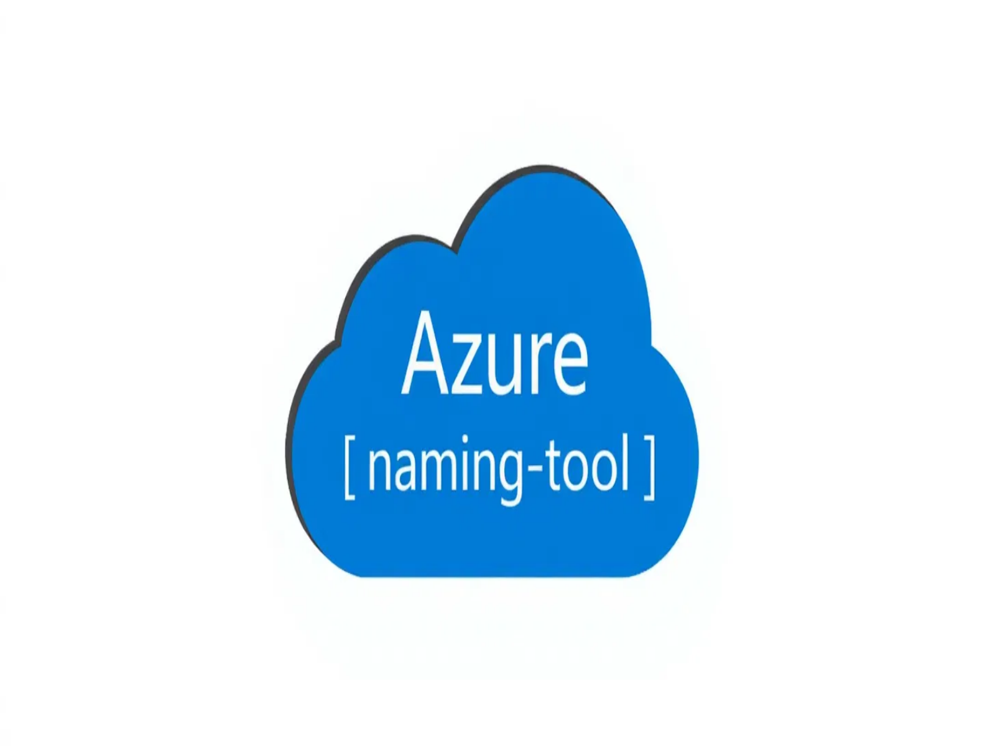
Azure Naming Tool Implementation
Automating naming conventions for Azure resources
Cloud Architecture Team | August 2025

Slide 2




Why Naming Conventions Matter
Inconsistent naming leads to management challenges
Without Conventions
With Conventions
Difficult to identify resources and their purposes
• webserver1
• vm-prod-web-westus-001
• app-server
• vm-prod-app-westus-001
• DB_PROD
• sqldb-prod-finance-
• storage-account-test
westus-001
Potential compliance and governance issues
• westus-vm01
• st-test-data-westus-001
• vm-prod-util-westus-001
Increased operational overhead
Azure Naming Tool Implementation | Cloud Architecture Team

Slide 3

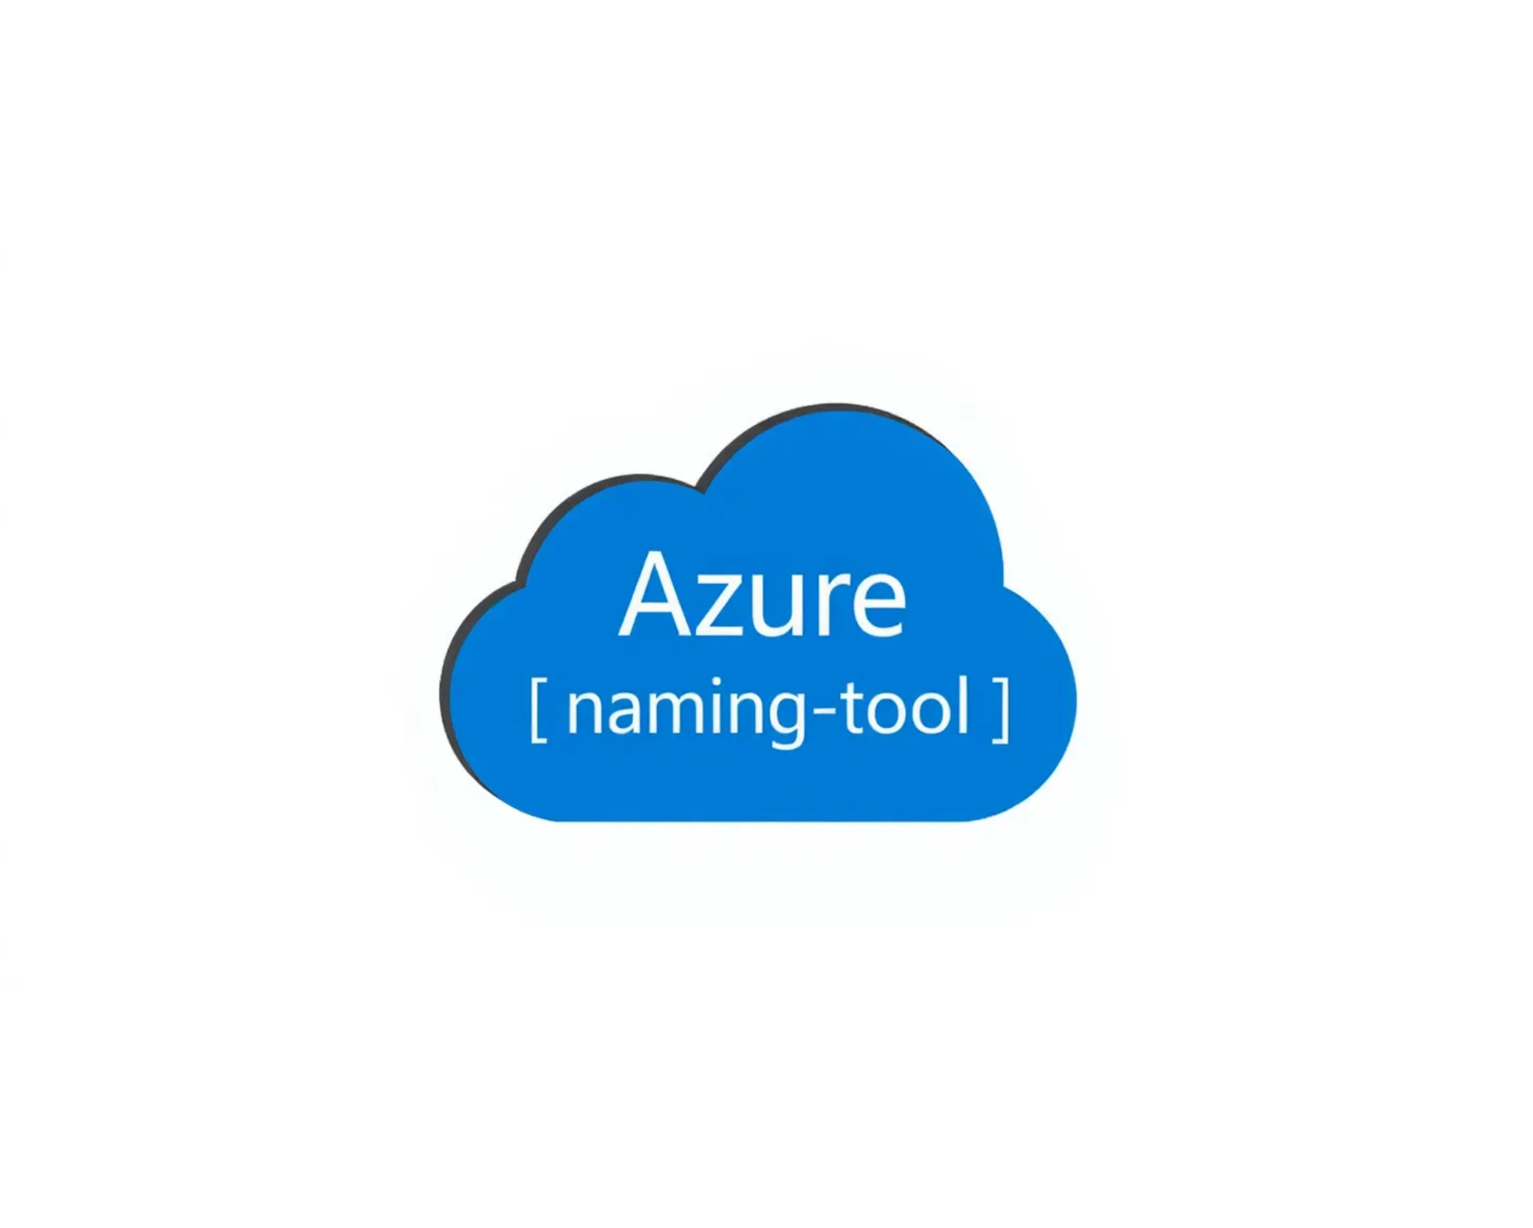



Azure Naming Tool Overview
Purpose
Helps administrators define and manage naming conventions while providing a simple interface for users to generate compliant names.
Technology
.NET 8 Blazor application with a RESTful API, can be deployed as a stand-alone application or container.
Best Practices
Based on Microsoft's recommended naming patterns for Azure resources.
User Roles
Administrators configure components, users generate compliant resource names.
Azure Naming Tool Implementation | Cloud Architecture Team

Slide 4
Deployment Method
1
Fork GitHub Repository
Create your own copy of the Azure Naming Tool repository.
2
Create Azure Web App
Deploy a .NET 8 Web App in Azure.
3
Enable Authentication
Configure Azure AD authentication for secure access.
4
Configure GitHub Secrets
Set up publishing profile and web app name.
5
Enable GitHub Action
Automate deployment on repository updates.
Azure Naming Tool Implementation | Cloud Architecture Team

Slide 5


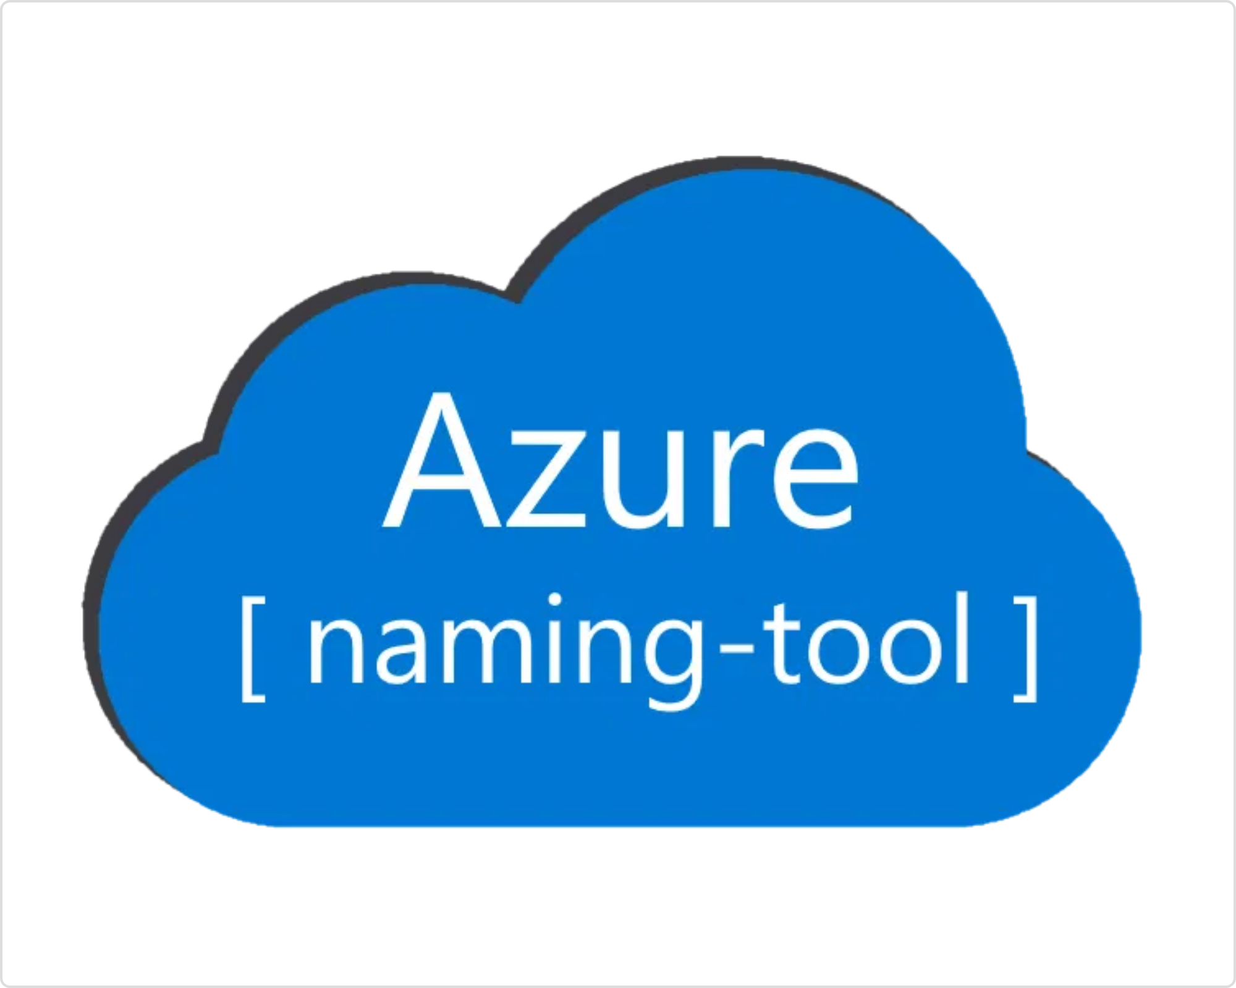


Tool Configuration
Base Configuration
Resource Types (vm, st, sqldb, etc.)
Delimiters (-, _, none)
Component Configuration
Environments (dev, test, prod)
Locations (westus, eastus, etc.)
Organizations (org, dept, team)
Projects/Applications/Services
Functions (app, web, api)
Security Configuration
Admin Password
API Key Management
Azure Naming Tool Implementation | Cloud Architecture Team

Slide 6

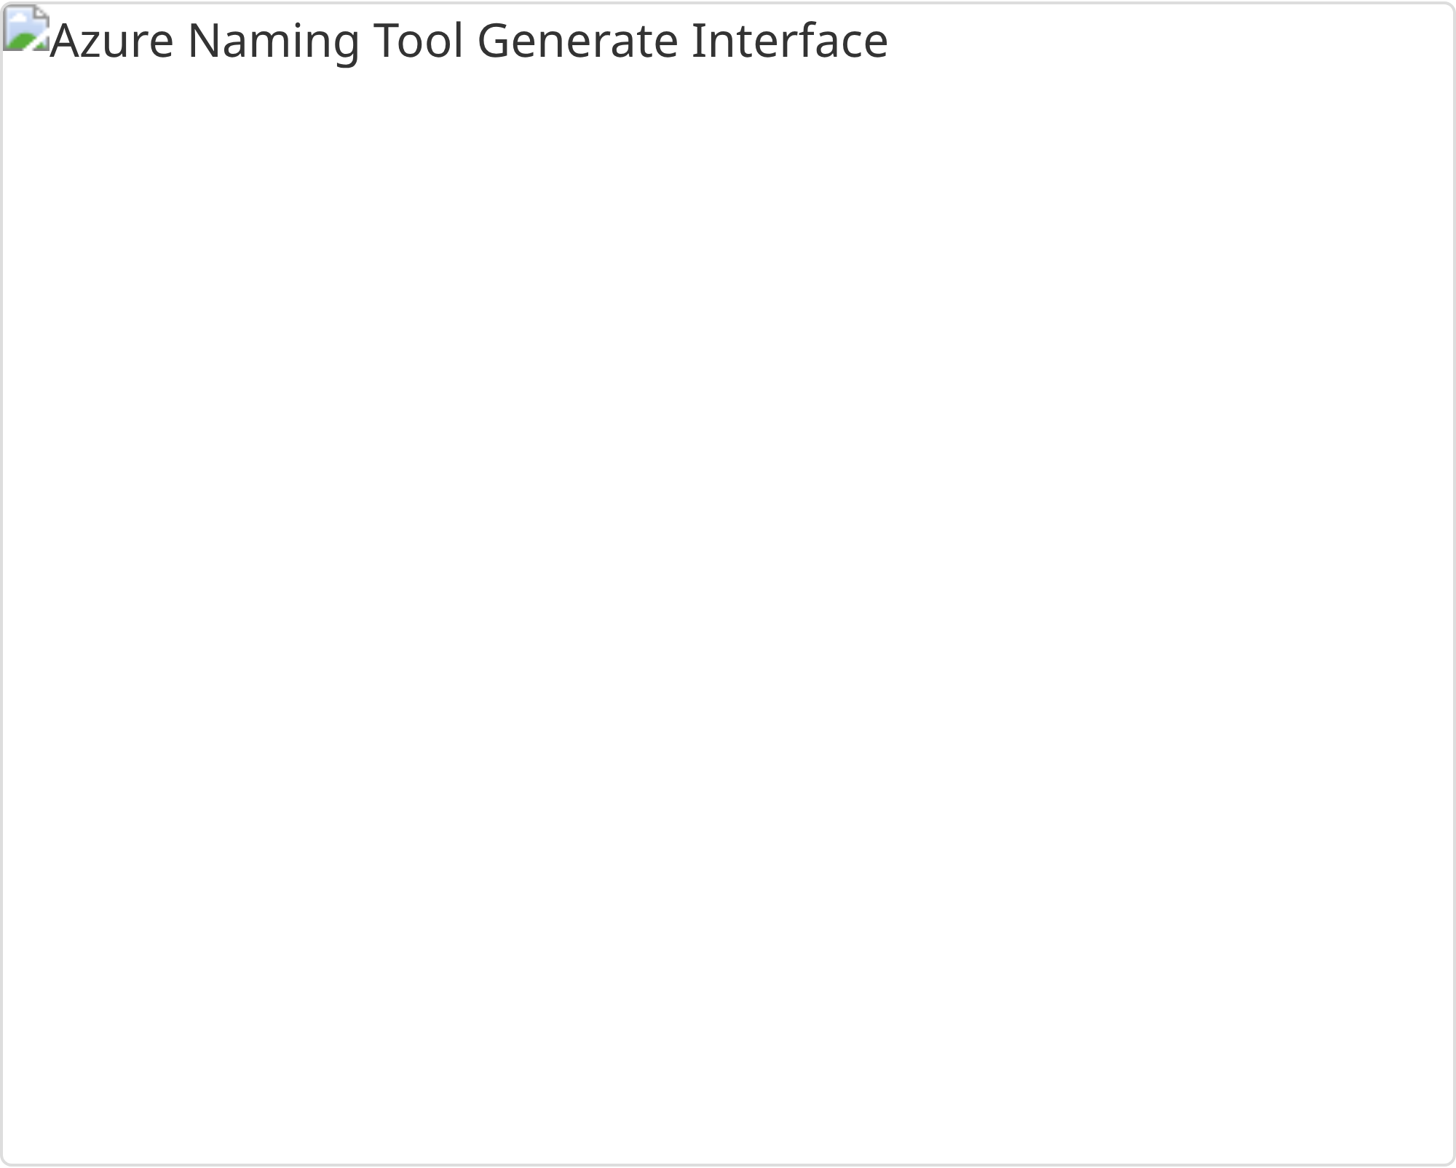
How to Use the Tool
1
Access the Tool
Navigate to the Azure Naming Tool URL and authenticate with your Azure AD credentials.
2
Select Resource Type
From the Generate page, select the Azure resource type you need to name from the dropdown menu.
3
Fill Required Components
Complete the form by selecting values for each naming component. Required components are marked and cannot be left blank.
4
Generate Name
Click the "Generate" button to create a compliant resource name based on your selections.
5
Use the Generated Name
Copy the generated name and use it when creating your Azure resource.
Azure Naming Tool Implementation | Cloud Architecture Team

Slide 7




API Integration
API Capabilities
The Azure Naming Tool includes a RESTful API that enables programmatic access to all naming functionality, allowing for integration with existing automation workflows.
Authentication
All API calls require an API key for authentication. This key is generated on first launch and can be updated in the Admin section.
// API Key Header
X-API-KEY: {your-api-key}
Sample API Call
// Generate a resource name
POST /api/ResourceNaming/GenerateResourceName
{
"resourceType": "vm",
"environment": "prod",
"location": "westus",
"org": "fin",
"appSvc": "sap"
}
Azure Naming Tool Implementation | Cloud Architecture Team

Slide 8

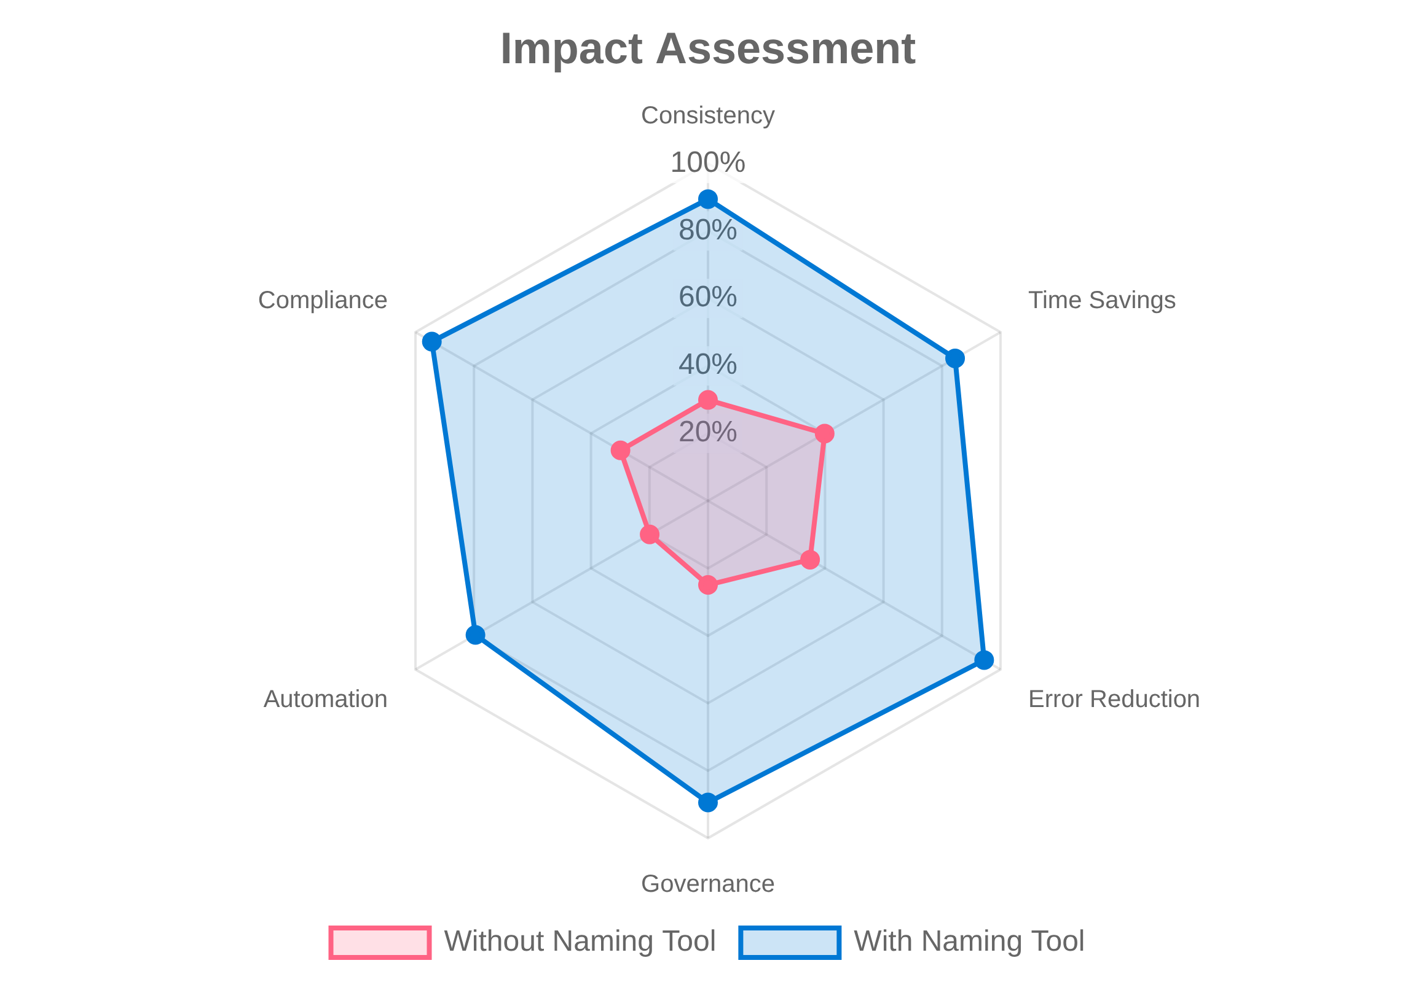




Benefits for Cloud Architects
Reduced Cognitive Load
No need to memorize complex naming rules for different resource types. The tool handles the complexity for you.
Increased Productivity
Quickly generate compliant names without manual verification, saving time during resource deployment.
Improved Collaboration
Standardized naming enhances communication across teams and reduces confusion about resource purpose.
Better Governance
Consistent naming facilitates resource tracking, management, and compliance with organizational policies.
Azure Naming Tool Implementation | Cloud Architecture Team

Slide 9

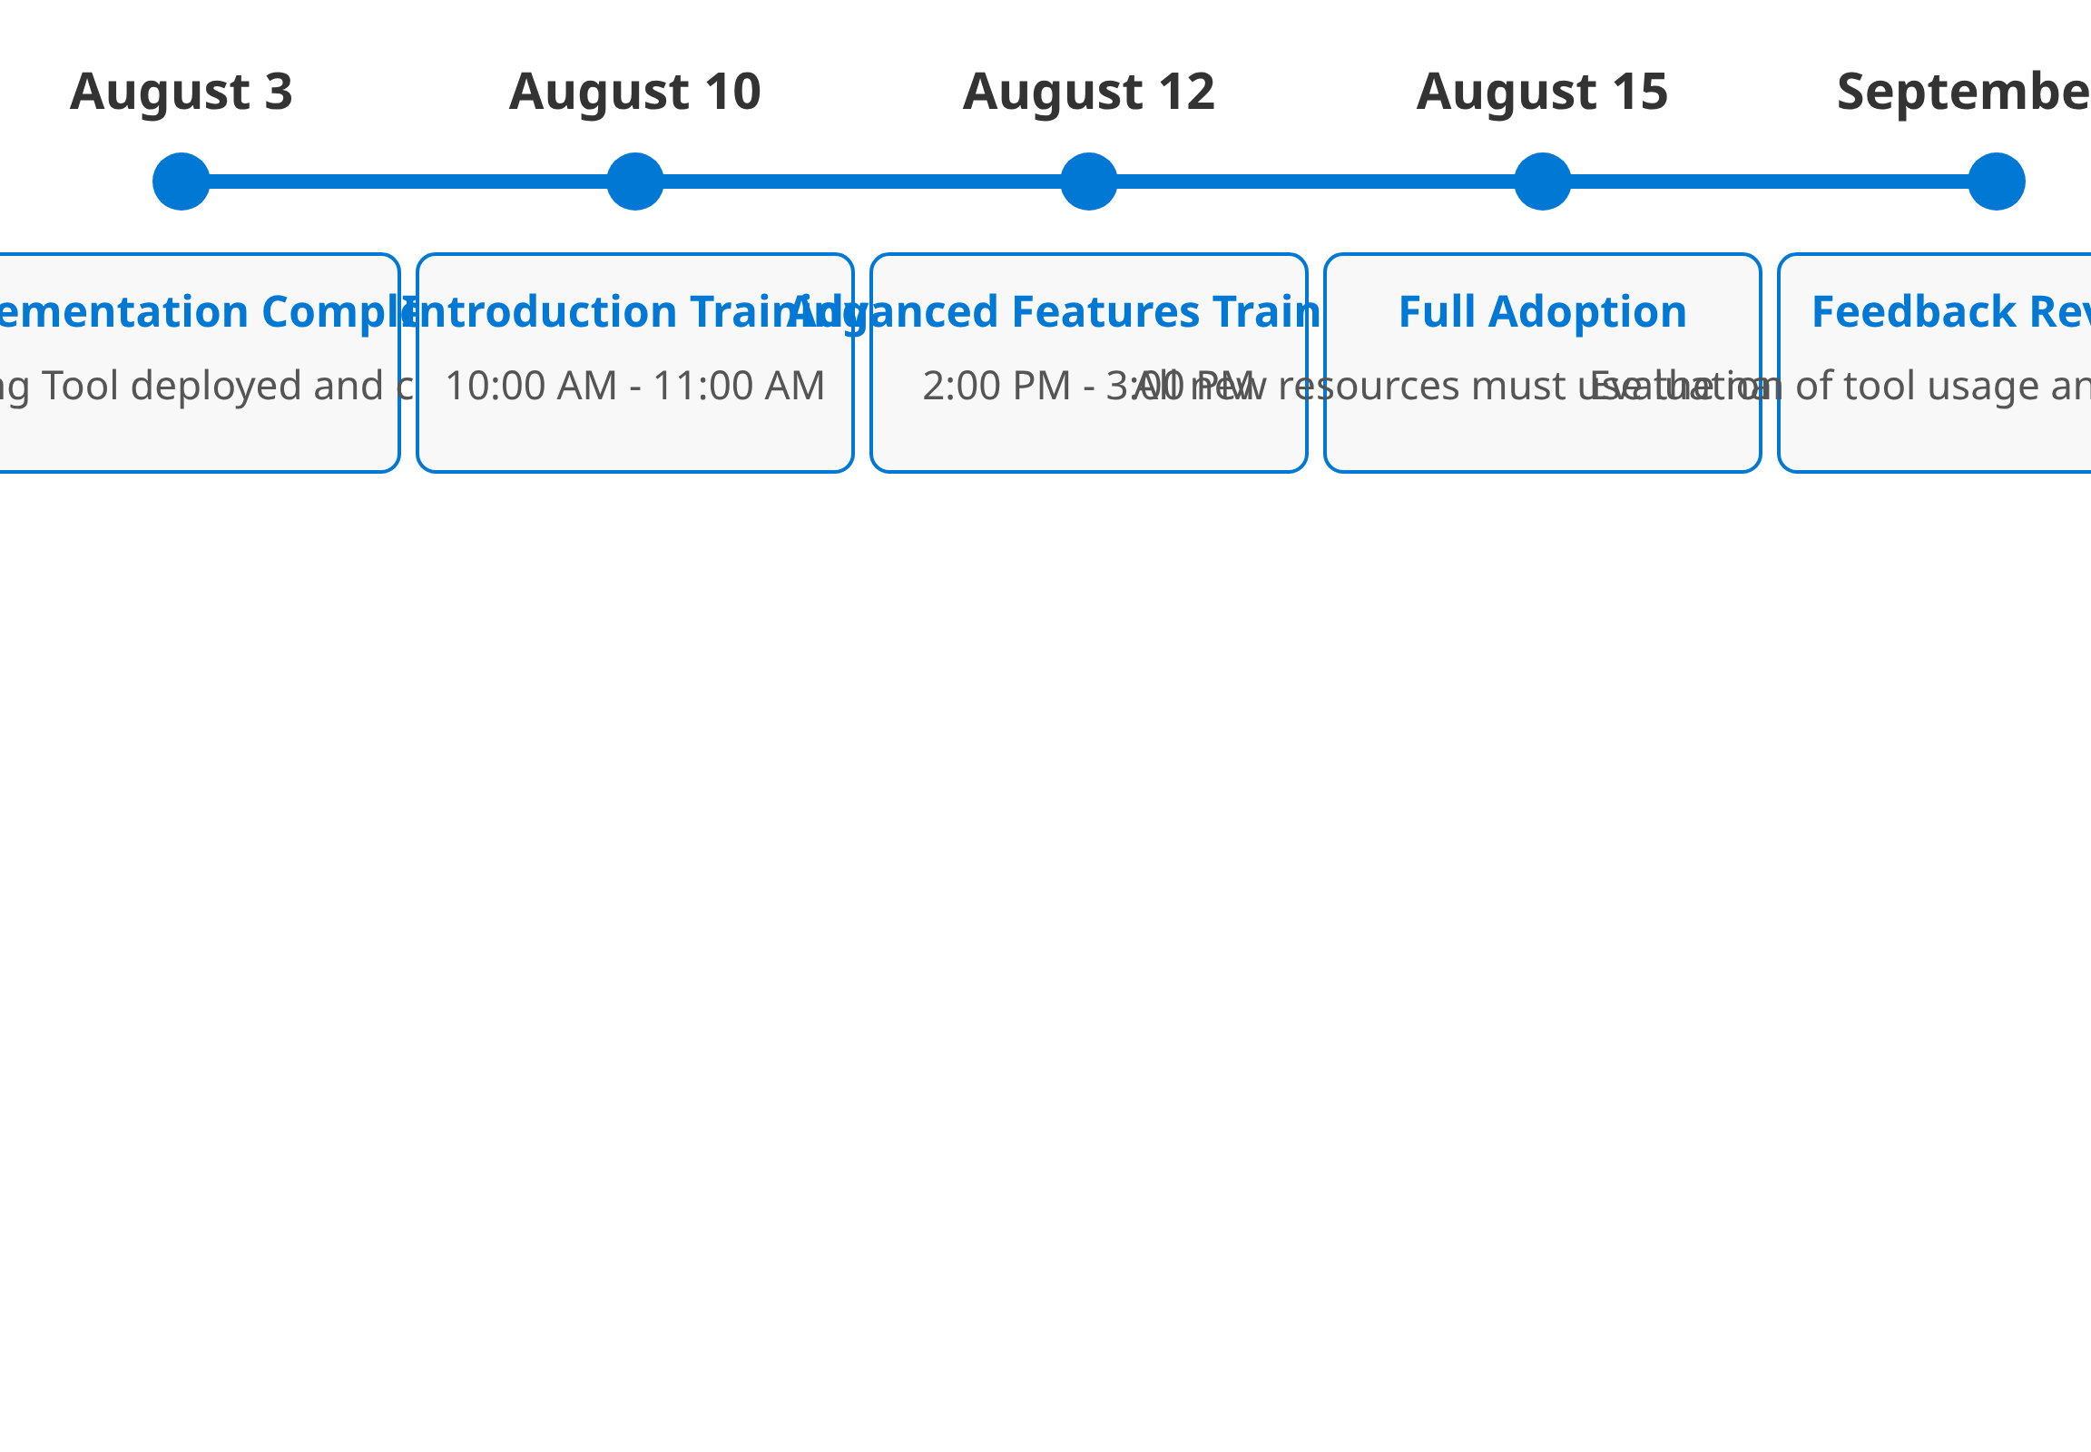



Next Steps
Start Using the Tool
Begin using the Azure Naming Tool for all new Azure resource deployments to ensure consistency.
Attend Training Sessions
Join the scheduled training sessions to learn more about the tool's features and capabilities.
Integrate with Workflows
Explore API integration options to incorporate the naming tool into your existing automation workflows.
Provide Feedback
Share your experience and suggestions to help us improve the tool and its implementation.
Azure Naming Tool Implementation | Cloud Architecture Team

Slide 10

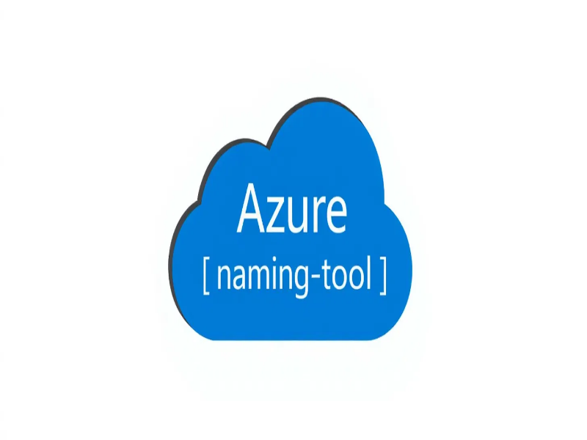





Questions?
We're here to help with your Azure Naming Tool implementation
cloud.infrastructure@organization.com
Ext. 5555
Additional Resources
Azure Naming Tool Implementation | Cloud Architecture Team
Documentation
Training Videos
GitHub Repository

